Slide 1
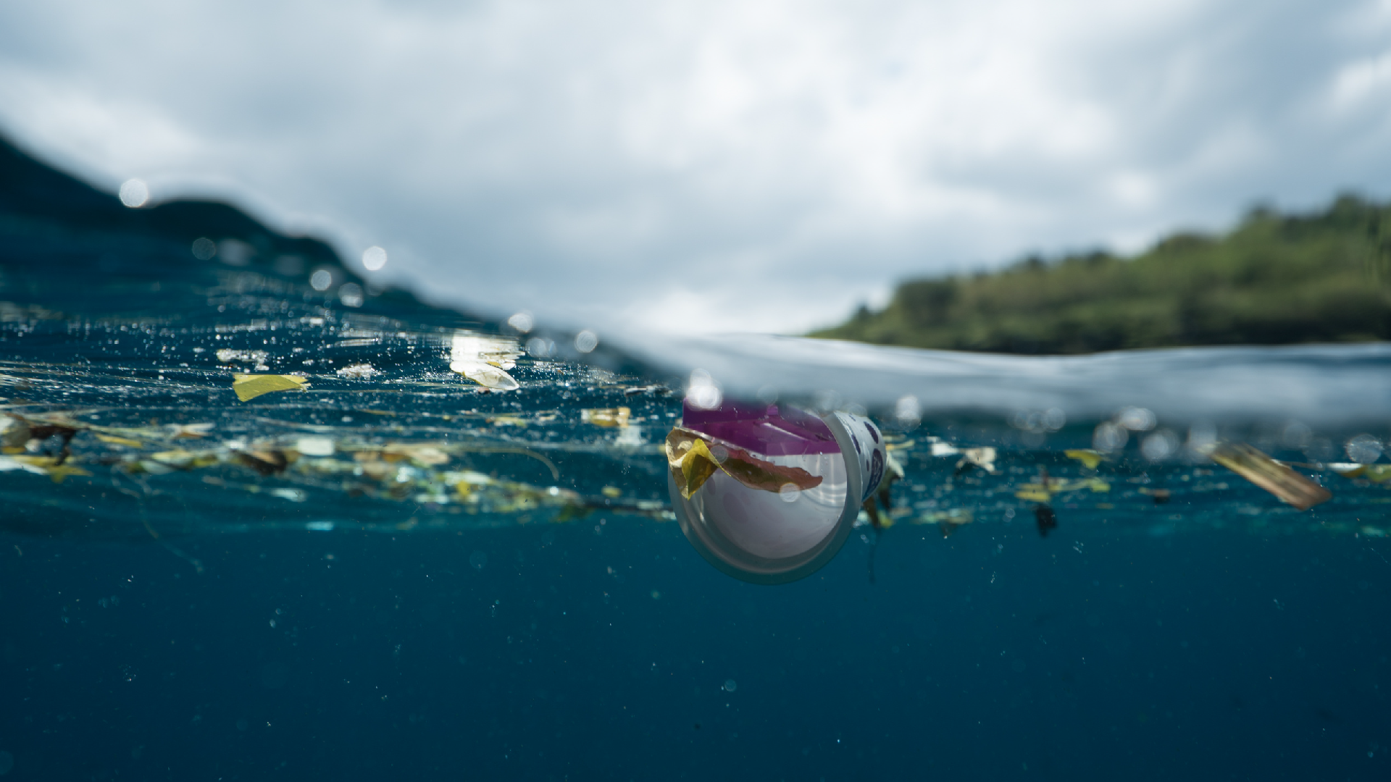
Water Pollution

Slide 2
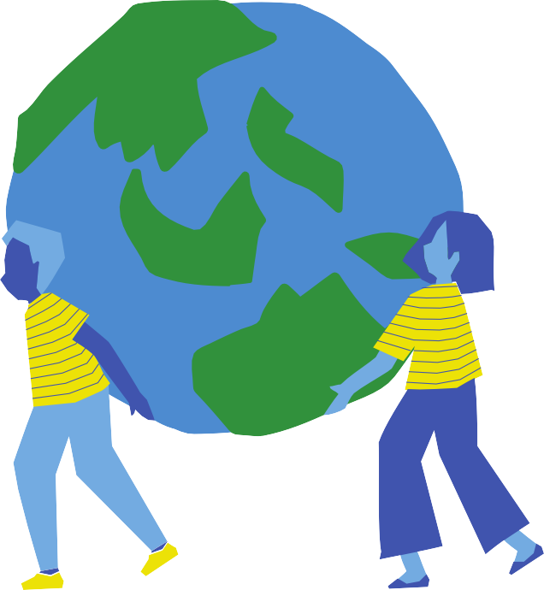
DID YOU KNOW
70% of the earth's surface is covered by water
Fresh water on earth is only 2.5% of the total water
The International Energy Agency projects that at the current pace, there will
NOT be enough freshwater available to meet global energy needs by 2040

Slide 3
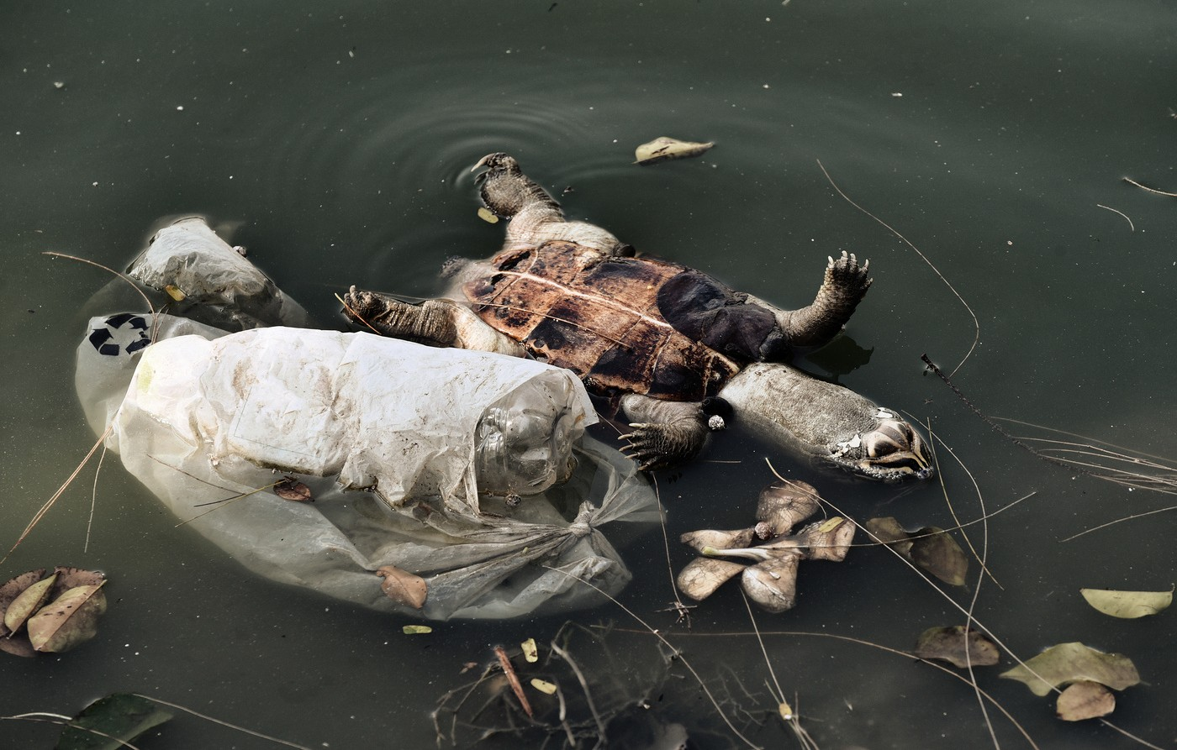
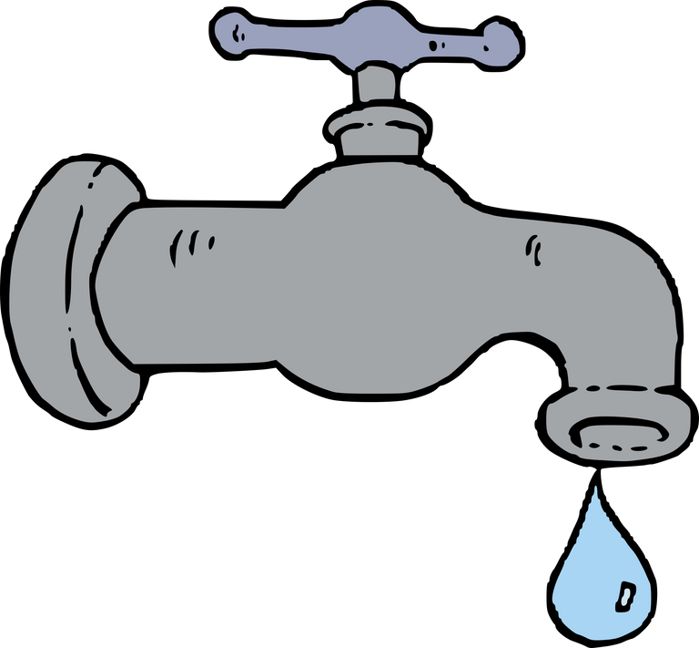
~ 250 million people succumb each year from diseases caused by the contaminated water
15 million children (< 5 y.o.) die every year from diseases caused by drinking contaminated water

Slide 4
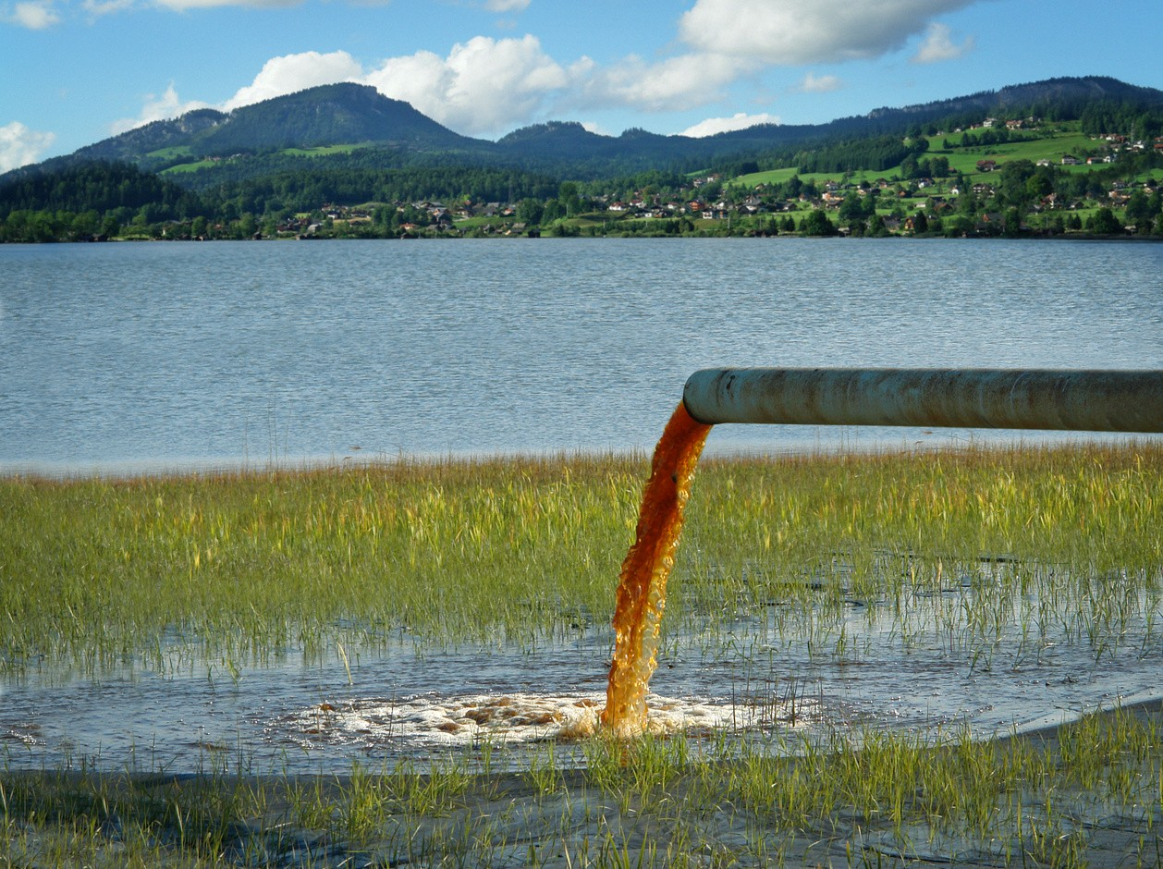
Agricultural waste (pesticides)
Every day, 2 million tons of sewage and industrial and agricultural waste are discharged into the world's water
Improper Sewage Disposal
- 80% of the water pollution -
CAUSES

Slide 5
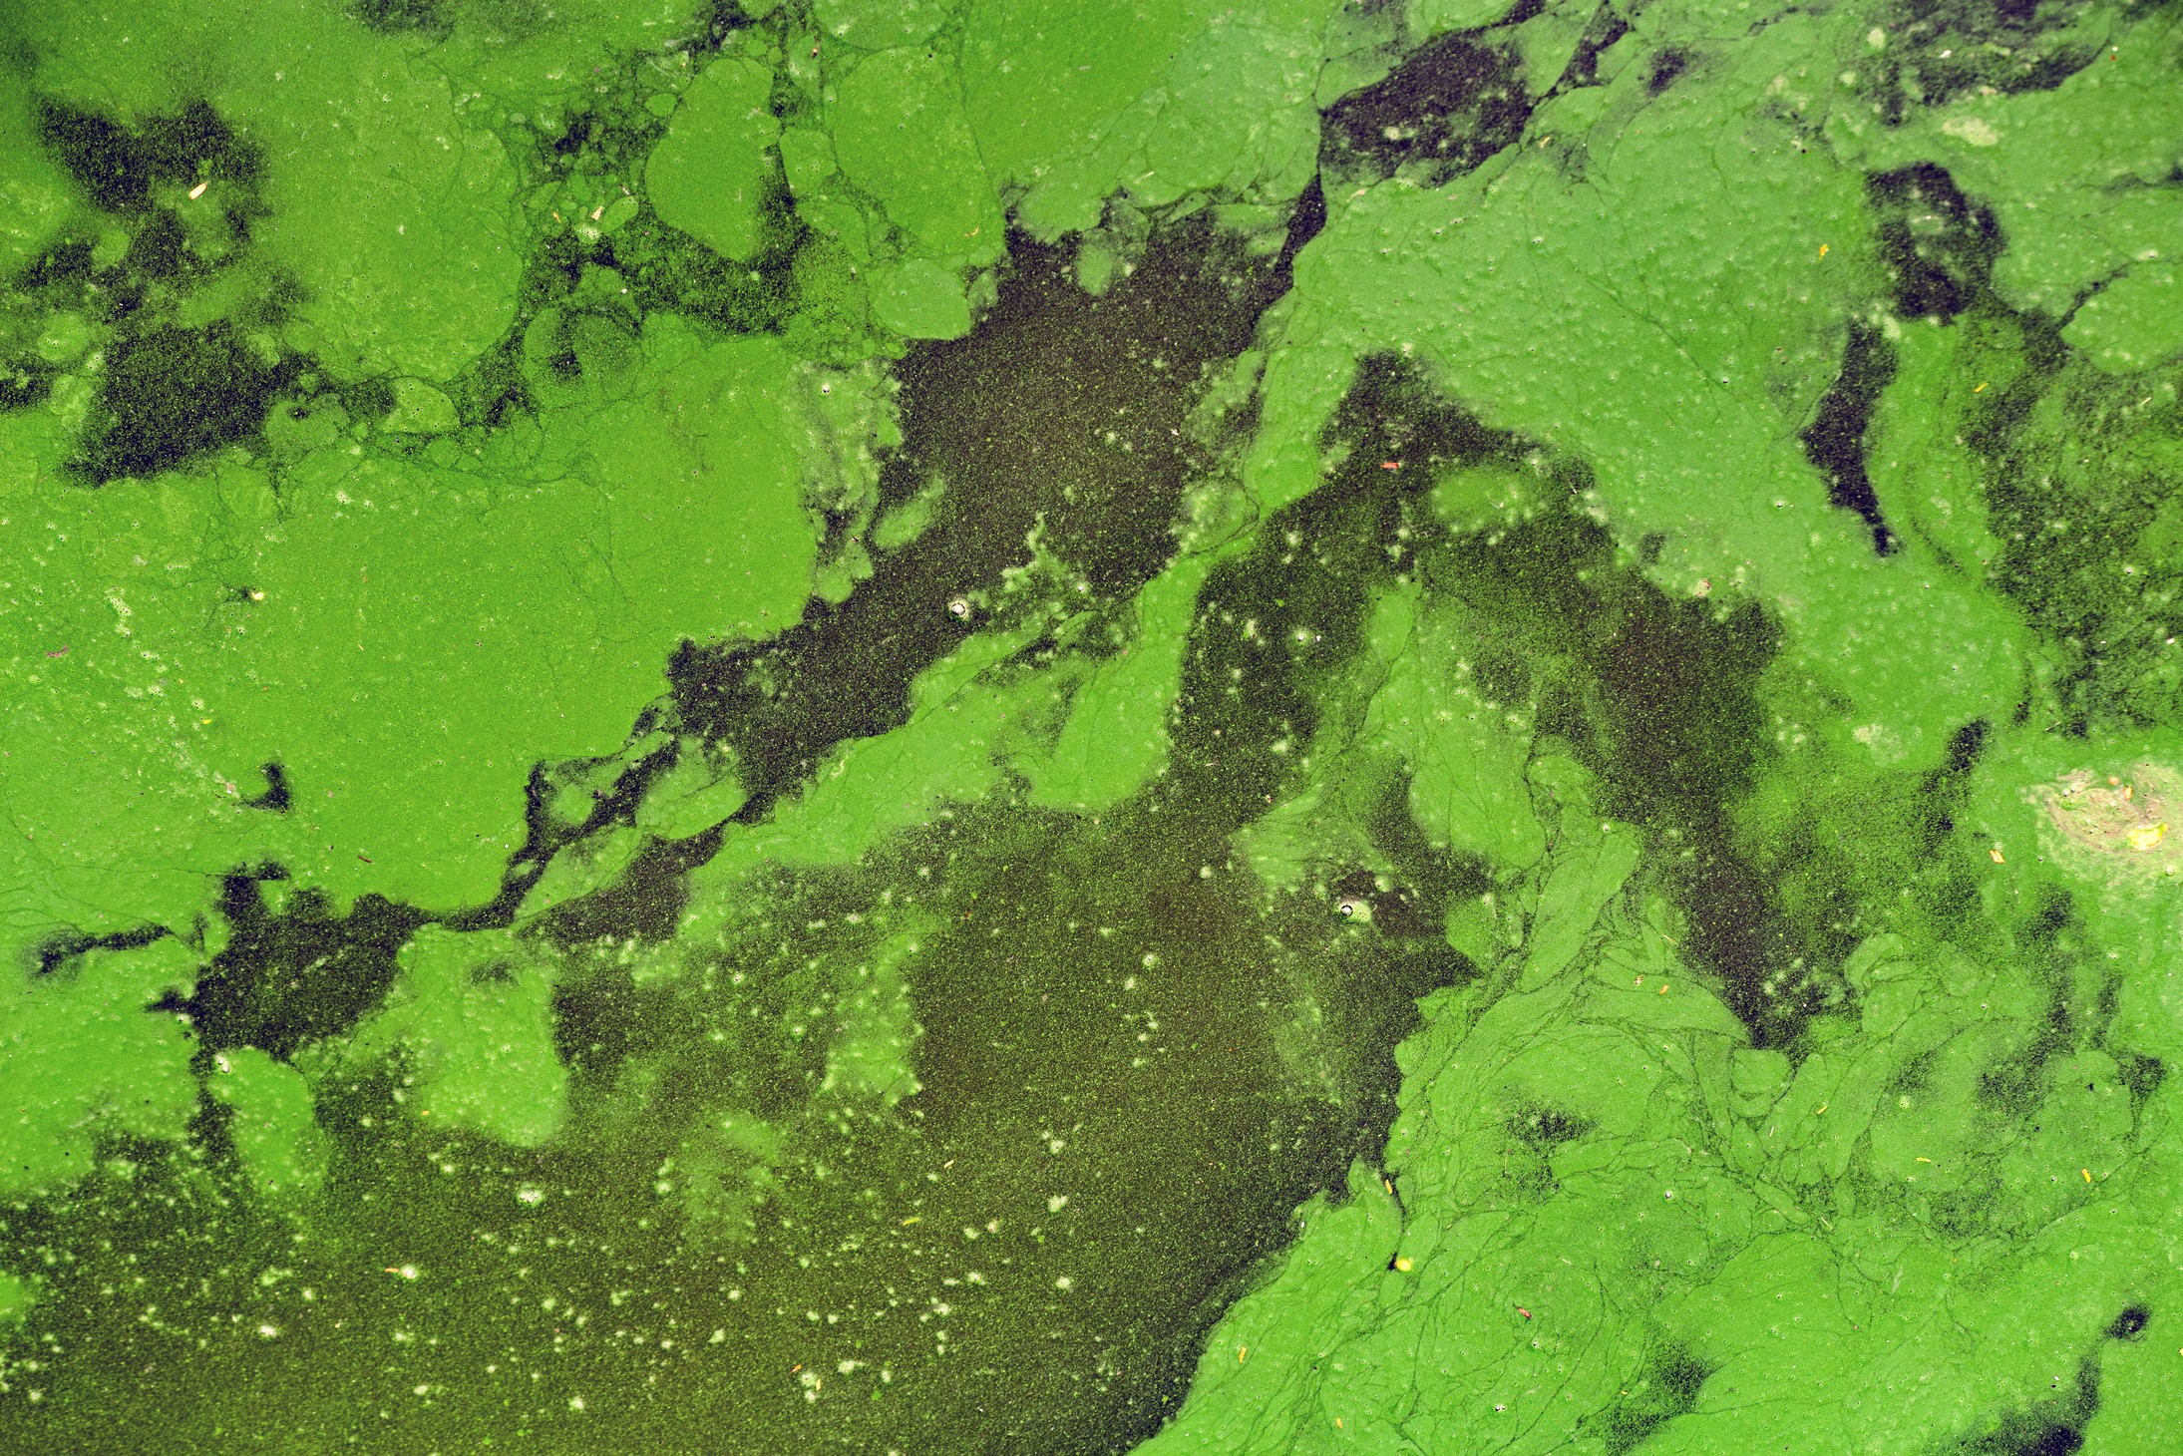
Oil Spills
Chemical Waste Dumping
~70% of industrial waste is dumped to water

Slide 6
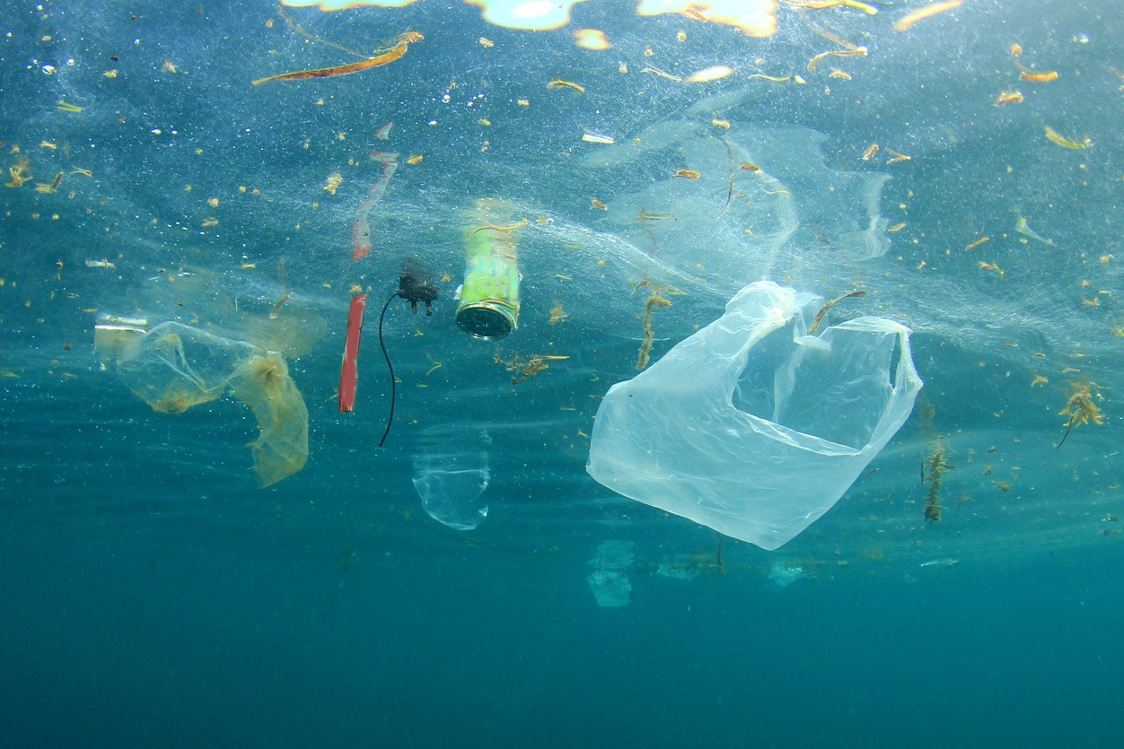
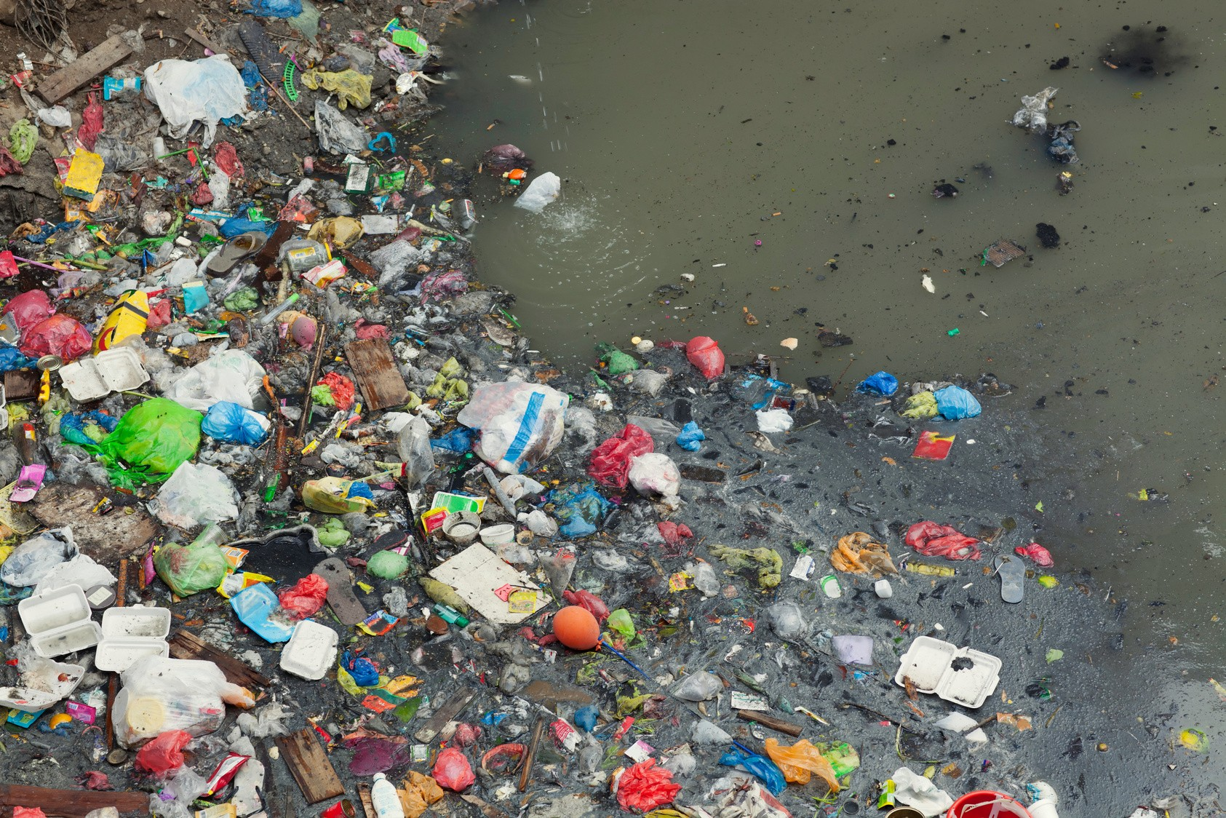
More than 6 billion pounds of garbage, mainly PLASTIC end up in the oceans every year
MICROPLASTICS

Slide 7
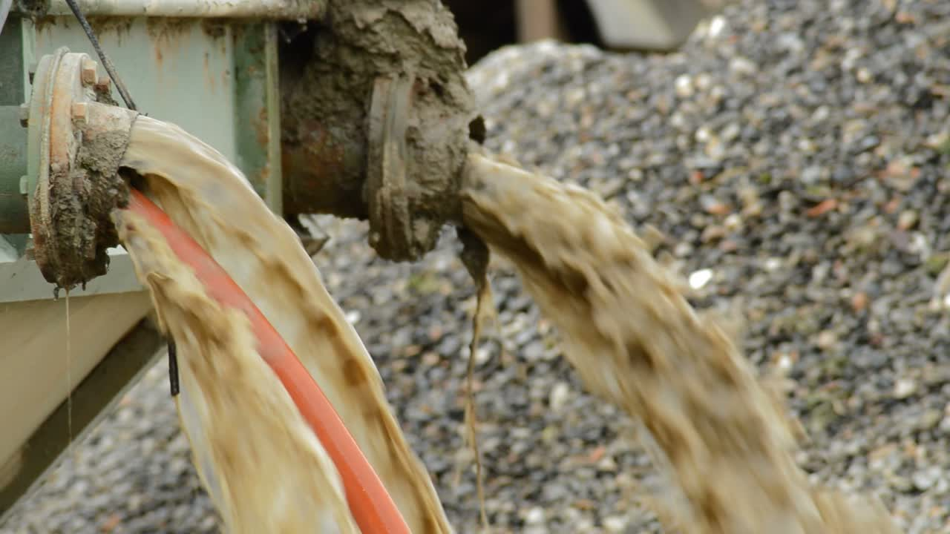
EFFECTS
Lack of potable water
Contamination of the food chain

Slide 8
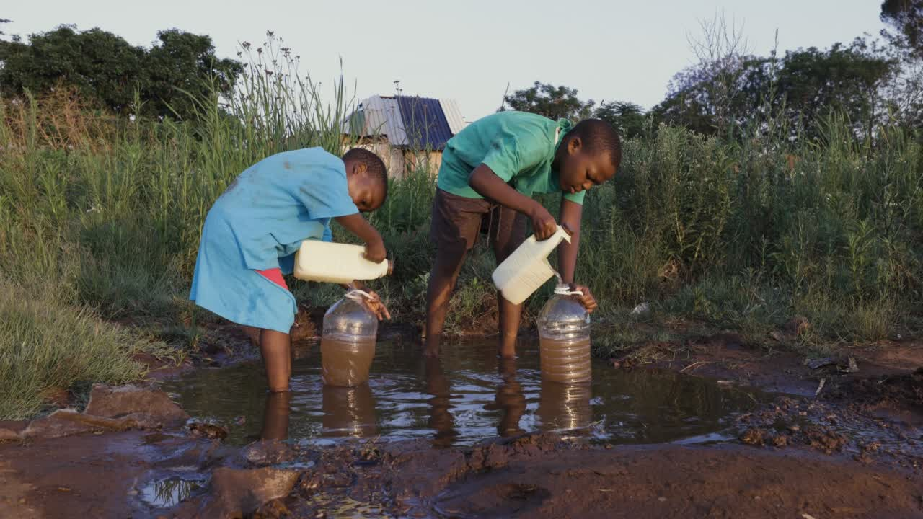
Diseases (such as cholera and typhus)
Infant mortality

Slide 9
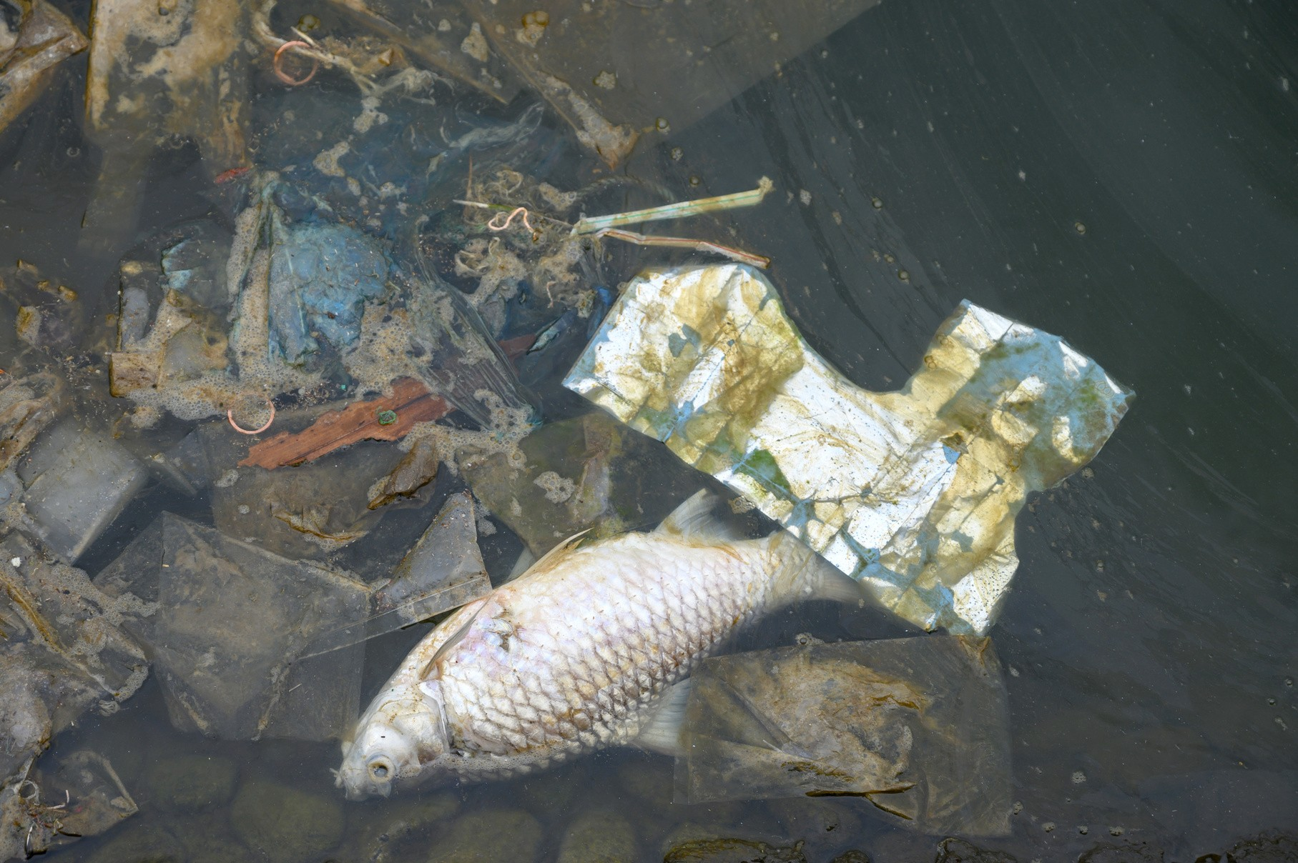
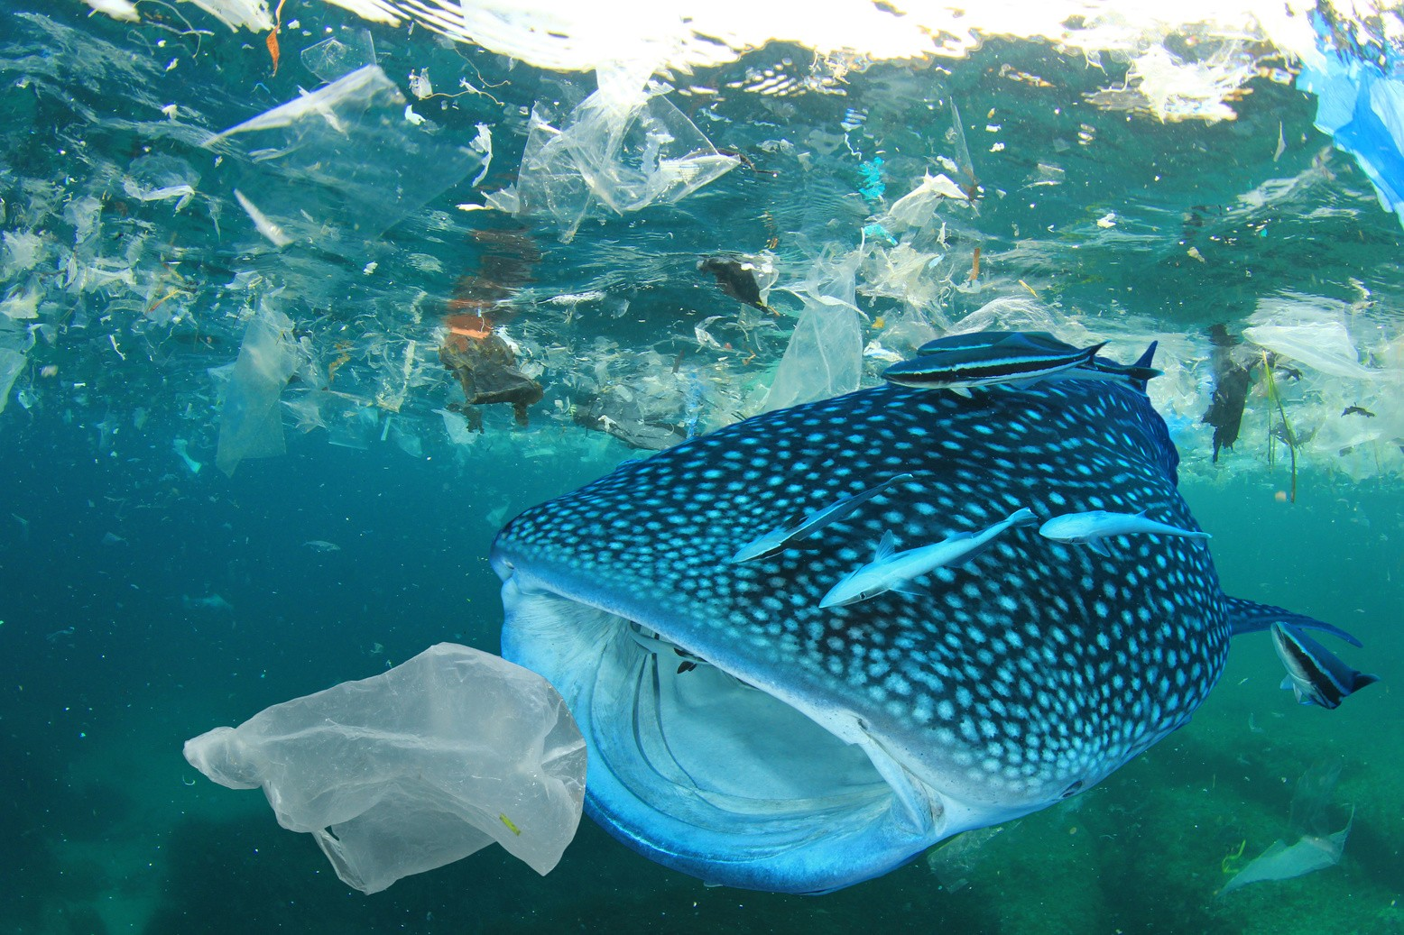
Destruction of biodiversity

Slide 10
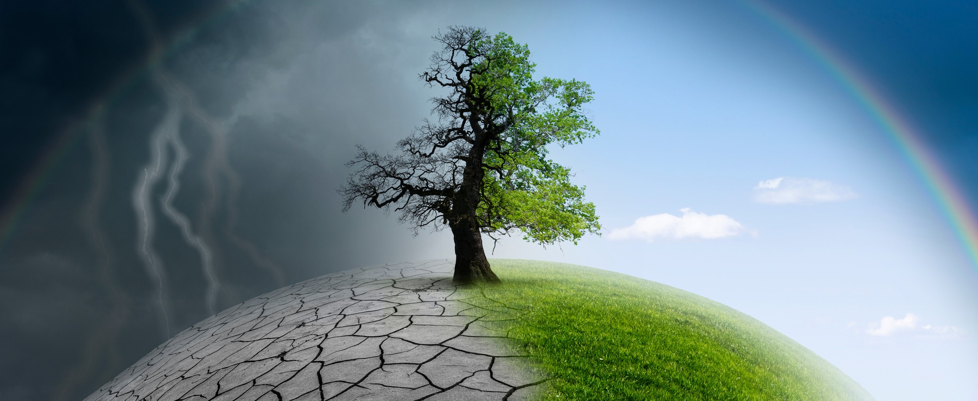
CHANGE starts with YOU !
Think GLOBAL, act LOCAL !
This project has received grant support from Movetia funded by the Swiss Confederation.
The content reflects the authors’ view and Movetia is not responsible for any use that may be made of the information it contains
Disclaimer: The European Commission's support for the production of this publication does not constitute an endorsement of the contents, which reflect the views only of the authors, and the Commission cannot be held responsible for any use which may be made of the information contained therein.

